Slide 1
INDIA- PHYSICAL FEATURES
PPT
Social Science
BY- M.S. JAI AADHARSH
GRADE VI-A

Slide 2
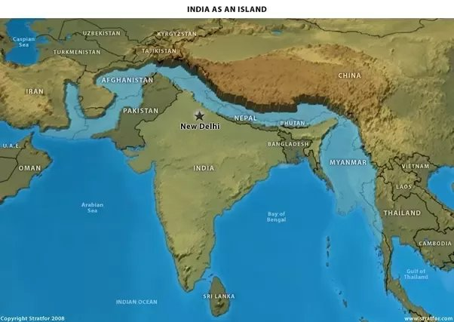
INTRODUCTION
THE INDIAN SUBCONTINENT
India, Pakistan, Nepal, Bhutan and Bangladesh are separated from the rest of Asia by the Himalayan mountain ranges. This region is called the Indian Subcontinent. A subcontinent is a big geographical unit which stands out distinctly from the rest of the continent.

Slide 3
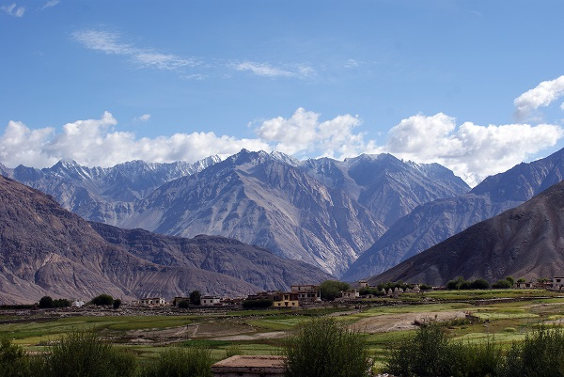
THE NORTHERN MOUNTAINS
THE PAMIR KNOT AND THE KARAKORAM MOUNTAINS
The Pamir Knot, due to its great height, is known as the ‘ Roof Of The World’. Several mountain ranges run in all directions from this knot. The Karakoram and the Himalayas are located along the northern frontier of India. The Karakoram mountains lie between the Pamir Knot and the Indus river in Jammu and Kashmir. It extends eastwards from the Pamir Knot for about 800 km. This region has many glaciers like Baltoro and Siachen. Mt Godwin Austen or K2 (8,611 m), the highest peak in India and the second largest is the Karakoram mountains.

Slide 4
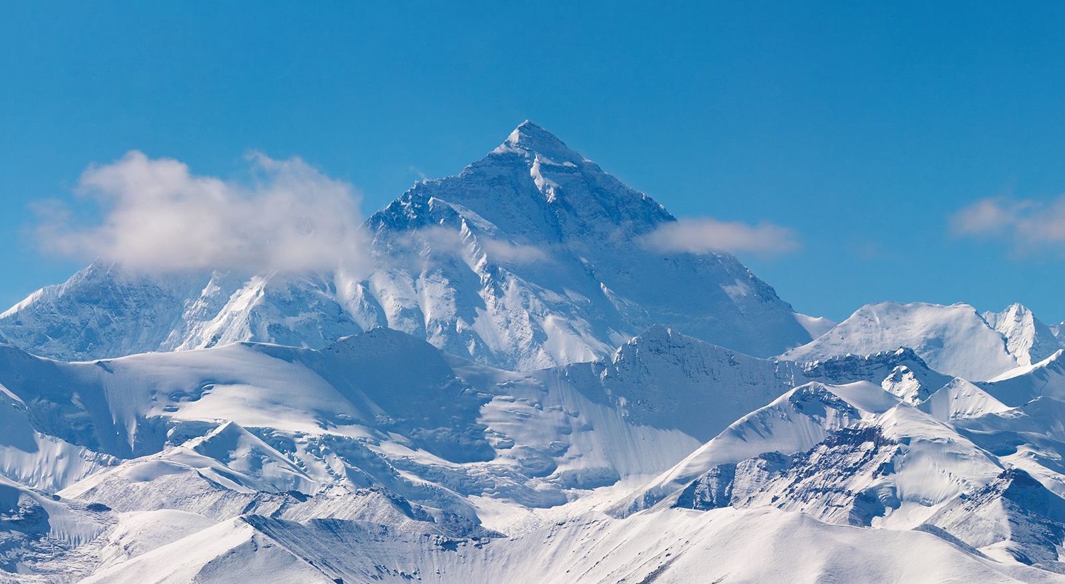
THE HIMALAYAS
The Himalayas extend from the Indus River in the west to the Brahmaputra river in the east. ‘Himalaya’ means the abode of snow. These mountains run from the west to east for about 2,500 km. The width varies from about 400 km in the west to about 150 km in the east. The Himalayas consist of three parallel ranges. From north to south, these are the Himadri, the Himachal and the Shiwalik. The height of these ranges decreases from north to south.

Slide 5
THE THREE PARTS OF THE HIMALAYAS
THE HIMADRI, HIMACHAL, AND SHIWALIK
HIMADRI
HIMACHAL
The Himadri or the Greater Himalaya is the highest mountain range in the world. Mt Everest (8,848 m) in Nepal is the highest peak in the world. Kanchenjunga (8,598 m) is the highest peak in the Indian Himalayan ranges.
The Himachal or the Lesser Himalayas lies towards the south of the Himadri. The important mountain ranges are the Pir Panjal and the Dhaula Dhar. Many popular hill stations such as Shimla, Dalhousie, Kullu, Manali, Mussoorie, Nainital and Darjeeling are situated in these mountain ranges.

Slide 6
The Shiwalik
Shiwalik or the Outer Himalaya is the southernmost mountain ranges. They are made up of loose deposits of soft rocks, mud and silt. Landslides are common in these areas. The Purvanchal ranges are found along the eastern boundary of India. They have Patkai Bum and the Naga Hills in the north and the Mizo hills in the south.
The cenral part has the Garo, Khasi and Jaintia hills.
Third part of Himalayas.

Slide 7
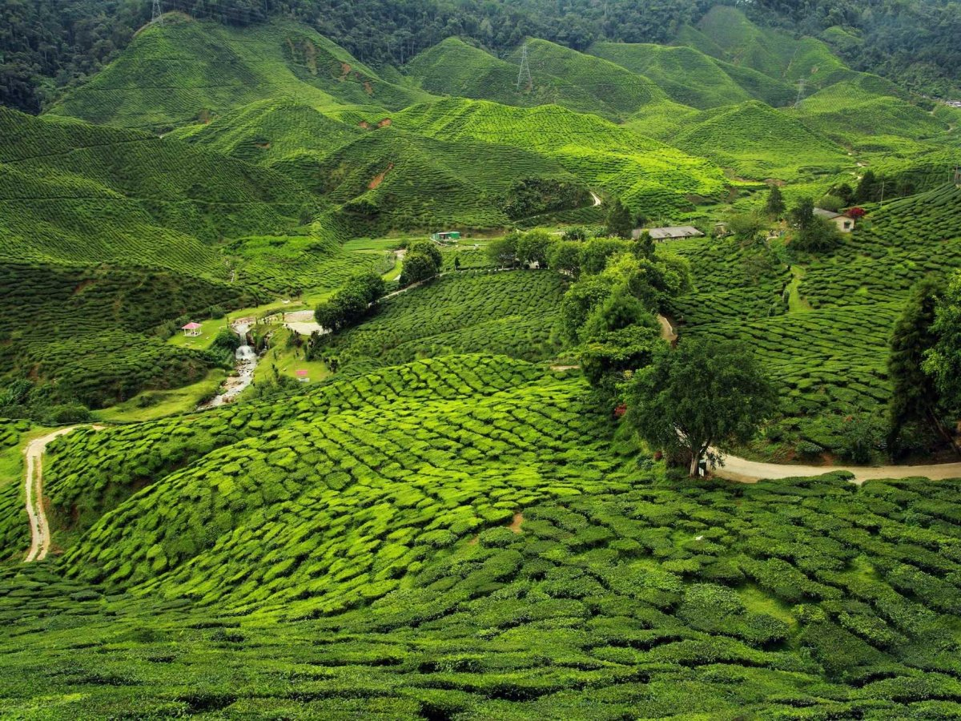
THE NORTHERN PLAINS
The northern plains occupy the greater part of northern India. It lies towards the south of the northern mountains. It is also known as the Ganga-Brahmaputra plain. It extends from the Satluj river in the west to the Brahmaputra river in the east, for about 2,400 km. The northern plains of India are made up of fine silt brought by the rivers coming from the Himalayas in the north and the Central Highlands in the south. This fertile silt is called alluvium. The thickness of the alluvium deposited by the rivers varies from place to place. The northern plains are divided into three parts.

Slide 8
THE THREE PARTS OF THE NORTHERN PLAINS
THE RAJASTHAN PLAIN, GANGA BASIN AND BRAHMAPUTRA VALLEY
RAJASTHAN PLAIN
GANGA BASIN
The Rajasthan Plain or the Great Indian Desert covers the western part of Rajasthan. The area has a number of short seasonal streams which are not able to reach the sea. Therefore, this is an area of inland drainage. The land is generally rocky and sandy.
The Ganga Basin covers the largest part of northern plains. It covers parts of Haryana, Rajasthan, Madhya Pradesh, Uttar Pradesh, Bihar and West Bengal. River Ganga originates from Gangotri glacier in the Himalayas and enters plains at Haridwar. The Ganga along with its tributaries such as Yamuna, Gomti, Ghaghara, Gandak and Kosi have deposited fertile alluvium. Chambal, Betwa, Ken and Son have also contributed to the formation of this plain.

Slide 9
THE BRAHMAPUTRA VALLEY
The Brahmaputra valley or the Assam plain lies in eastern India. The Brahmaputra river originates in Tibet, where it is known as Tsangpo. This river brings a large amount of silt. From Assam, it enters Bangladesh where it is called Jamuna. The Ganga and the Brahmaputra join together and form the largest delta in the world- the Sundarbans.
The northern plains have many advantages, such as:
A flat surface for building roads and railways.
New deposits of alluvium every year..
Rivers provide water for irrigation,
A favourable climate for round-the-year farming.
THIRD PART OF NORTHERN PLAINS

Slide 10
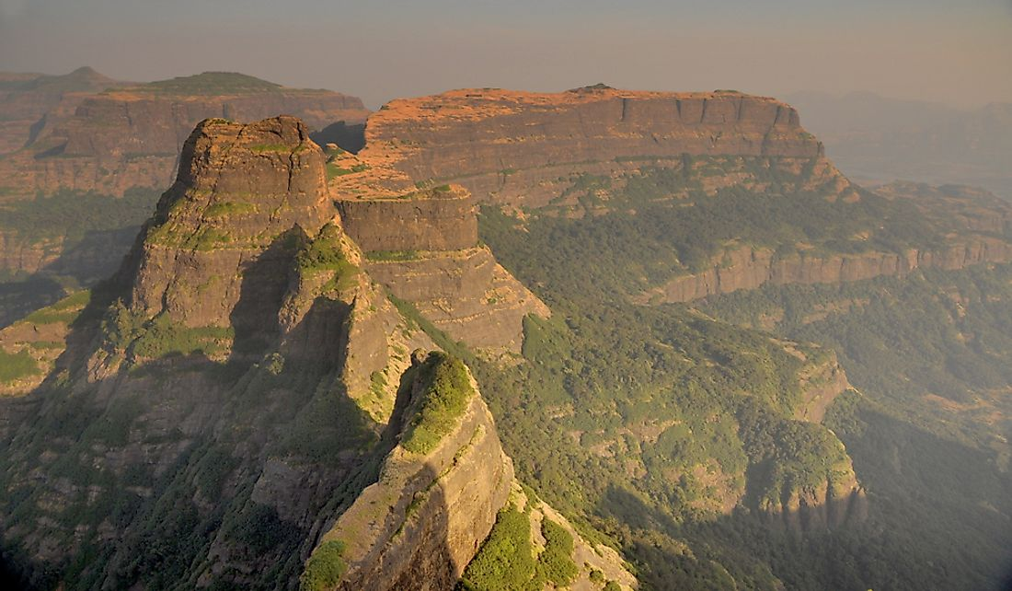
THE PENINSULAR PLATEAUS
The Peninsular Plateaus are located towards the south of the northern plains. It is roughly triangular in shape. It is the oldest structure of the Indian Subcontinent. The plateaus are surrounded by hill ranges on all the three sides. To the north are the Aravallis, the Vindhyas, the Satpuras and the Rajmahal hills. The Western Ghats and the Eastern Ghats form its western and eastern boundaries respectively. The Narmada river divides the entire plateau region into two parts- the Central Highlands and the Deccan Plateau.

Slide 11
THE TWO PARTS OF PENINSULAR PLATEAU
THE CENTRAL HIGHLANDS AND THE DECCAN PLATEAU
CENTRAL HIGHLANDS
DECCAN PLATEAU
The Central Highlands from the northern part. They have a series of plateaus, such as Malwa, Bundelkhand, Baghelkhand and Chotanagpur. These plateaus are made up of hard igneous rocks. All the rivers from the Central Highlands join the Yamuna and the Ganga from the south.
The Deccan Plateau extends from the Vindhyas in the north to the southern tip of the peninsula. It is bounded by the Western Ghats and the Eastern Ghats. Both these hill ranges meet at Nilgiri hills. The Western Ghats, also known as the Sahyadri, have the Sahyadri hills, the Nilgiris, Anaimalai and the Cardamom hills. Anai Mudi (2,695 m) is the highest peak in Deccan Plateau. The Eastern Ghats are broken into small hill ranges by rivers such as Mahanadi, Godavari, Krishna and Kaveri.

Slide 12
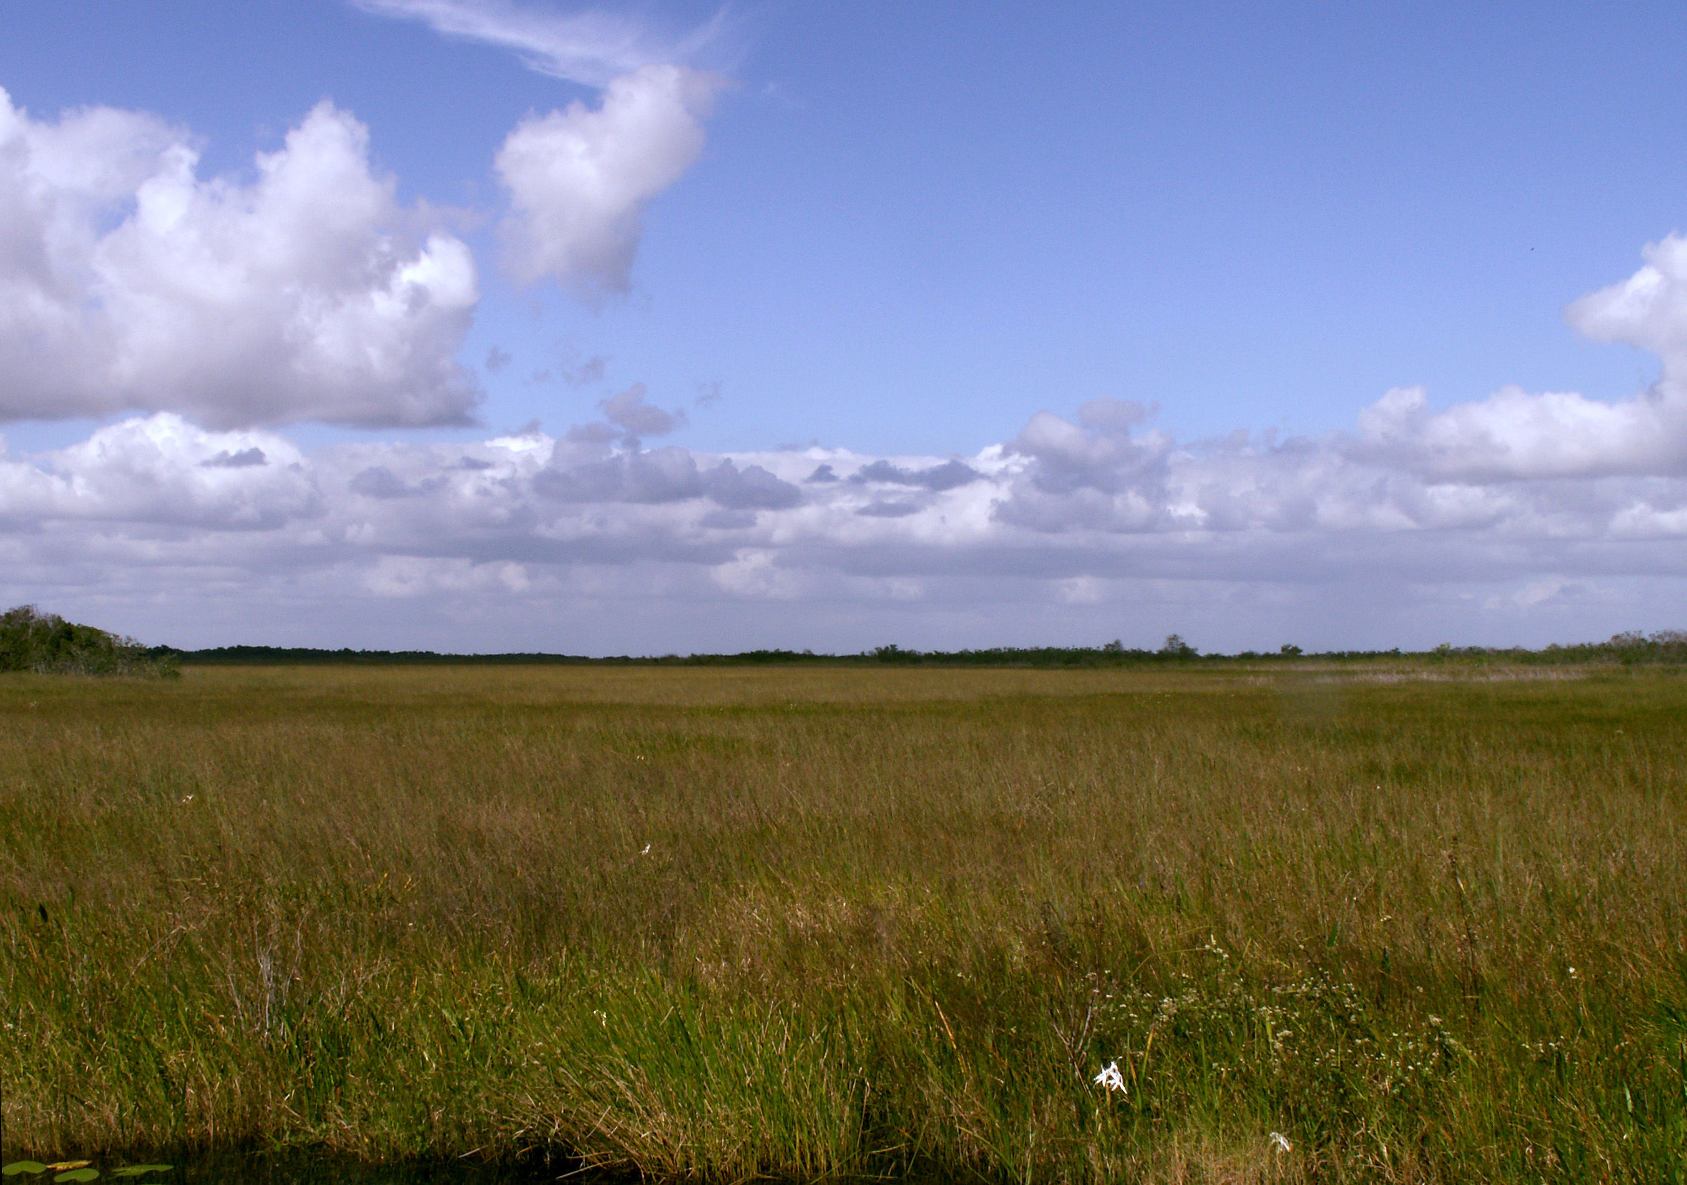
THE COASTAL PLAINS
The Deccan plateau is bounded by Coastal Plains in the east and west. They run for about 6,100 km from the Rann of Kachchh in the west to West Bengal in the east. The Western and Eastern coastal plains meet at Kanniyakumari, the southernmost tip of the Indian mainland. The eastern coast is broader than the western coast.

Slide 13
THE TWO PARTS OF COASTAL PLAINS
THE WESTERN AND THE EASTERN COASTAL PLAINS
WESTERN COASTAL
EASTERN COASTAL
The northern part of the Western Coastal plain is called the Konkan Coast and the southern part is called as the Malabar Coast. The backwaters, locally called kayals, are a special feature of the Malabar coast.
The northern part of the Eastern Coastal plain is called the Northern Circars and the southern part is called the Coromandel coast. Rivers such as Mahanadi, Godavari, Krishna and Kaveri have formed fertile deltas along the Eastern coastal plain.

Slide 14
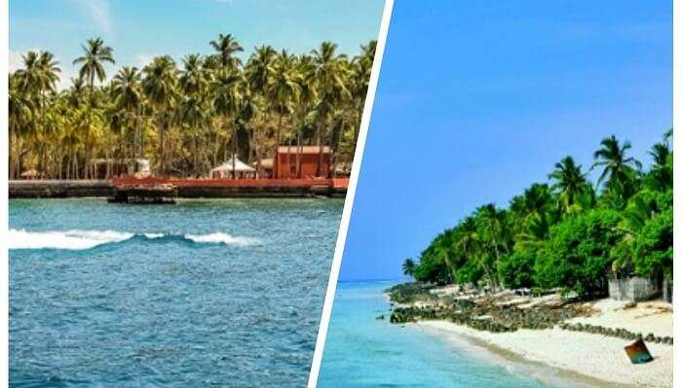
THE ISLANDS
Apart from several islands found along the coast of India, there are two main groups of islands. One of them is the Lakshadweep islands in the Arabian Sea and the other is the Andaman and Nicobar Islands in the Bay Of Bengal. Minicoy, with an area of about five sqare km, is the largest island in the Lakshadweep group. The Andaman and Nicobar group stretches for a distance of about 600 km. Most of these islands are mountainous and are covered with thick forests.

